Slide 1
MACHINE LEARNING ASSIGNMENT - LIFE EXPECTANCY DATASET ANALYSIS
By- VARSHINI SREE J K

Slide 2
PROBLEM STATEMENT DATA SET – Life Expectancy
The objective of this study is to analyse the 'Life Expectancy' dataset, which encompasses a comprehensive range of health and economic indicators across various countries. The primary goal is to investigate the intricate relationships and influences of these diverse factors on the average life expectancy in each country.
This research endeavours to offer actionable insights, contributing to informed decision-making in the realms of public health and policy formulation.

Slide 3
DATASET OVERVIEW
This analysis involves employing advanced analytical methodologies, to pinpoint the pivotal elements that exert substantial influence on life expectancy in each country.
The dataset comprises 124 rows each representing a unique country.
It encompasses 18 columns featuring a diverse range of health and economic indicators
A size of 2232 indicates that this dataset offers a comprehensive perspective on factors influencing life expectancy

Slide 4
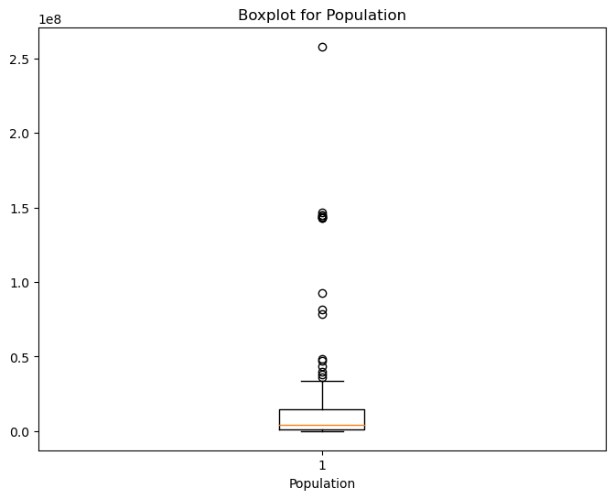
OUTLIER CHECK
On performing the outlier check using boxplot ‘Population’ tends to have potential outliers with extreme values
Considering the risk, the outliers present in ‘Population’ have been removed

Slide 5
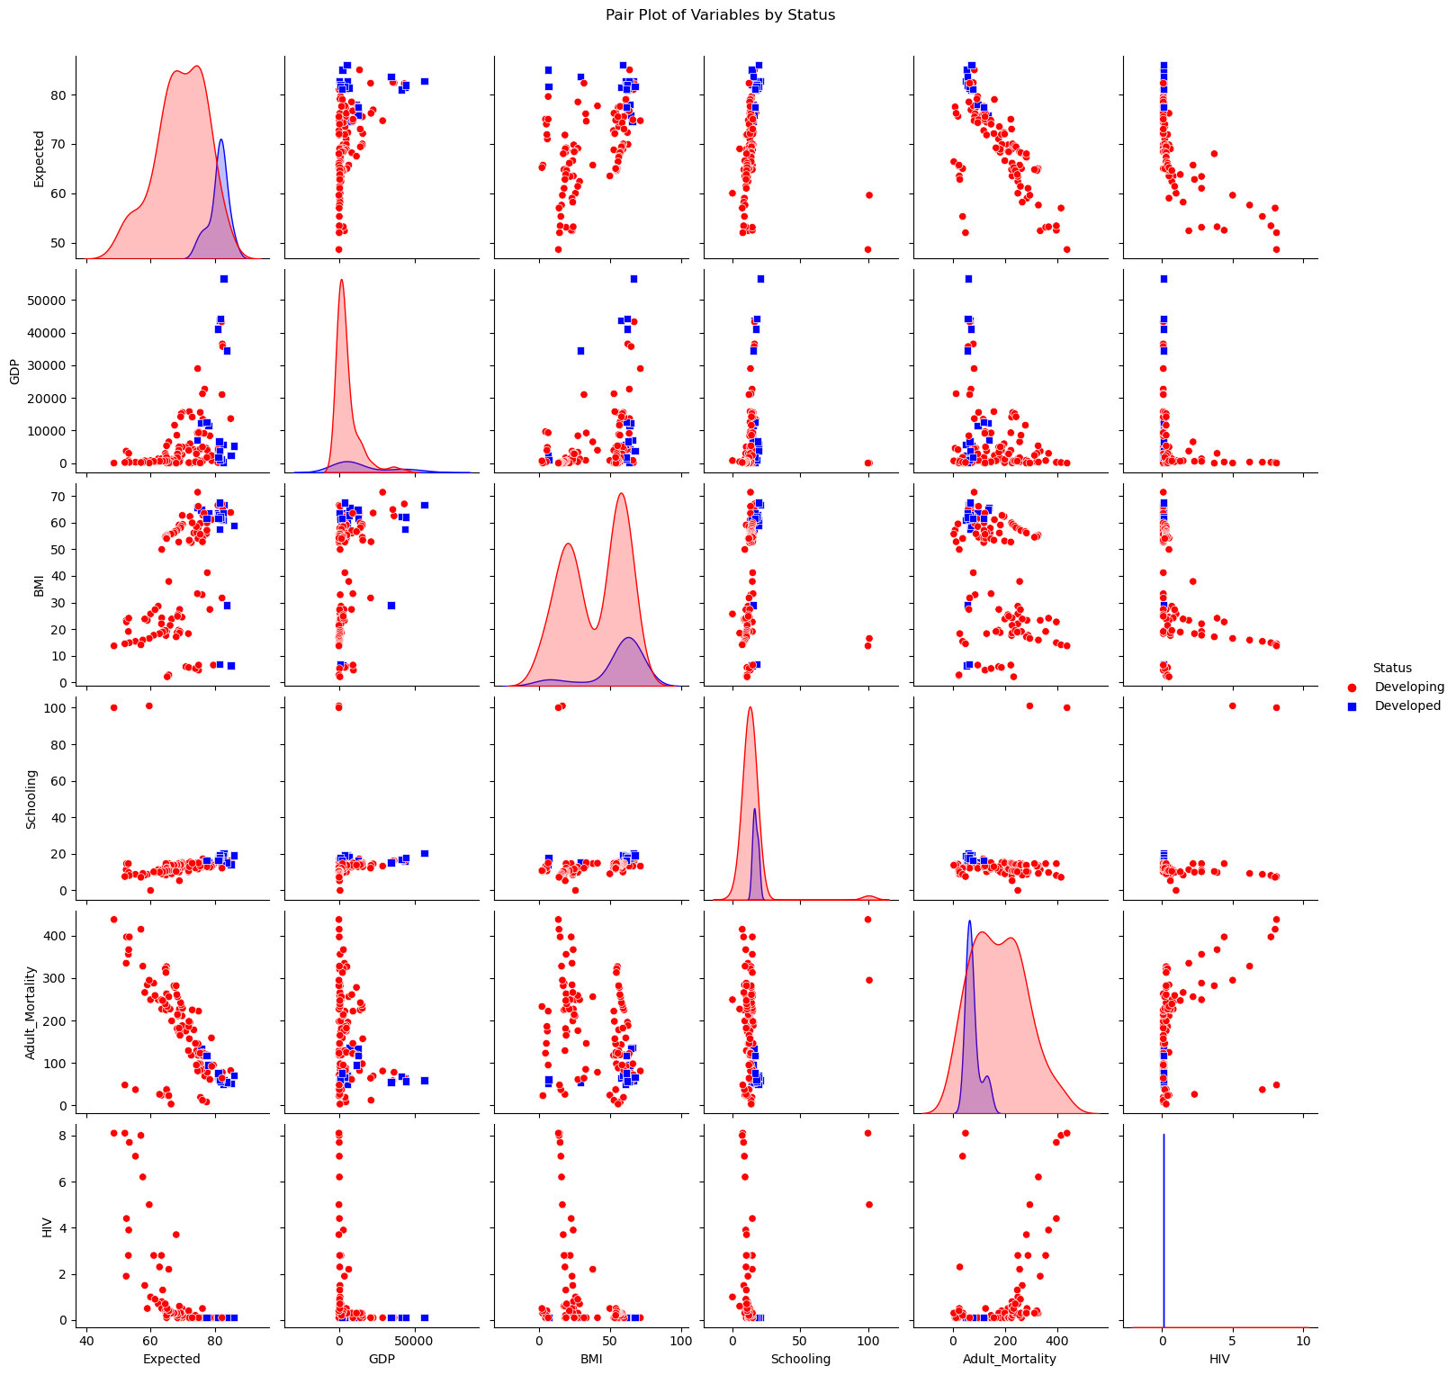
EXPLORATORY ANALYSIS OF LIFE EXPECTANCY VARIABLES - INSIGHTS FROM PAIR PLOT ANALYSIS BY COUNTRY STATUS
PAIRPLOT
INSIGHTS
To understand the relationships between various health and economic variables and life expectancy, with a focus on differentiating between 'Developed' and 'Developing' countries
The pair plot visually represents relationships between key variables influencing life expectancy
Blue markers represent 'Developed' countries, while red markers represent 'Developing' countries
Eg. Life Expectancy with respect to adult mortality is higher in developed countries compared to developing countries.
Developed countries have fewer deaths due to HIV and have have higher life expectancies. treatment strategies.

Slide 6
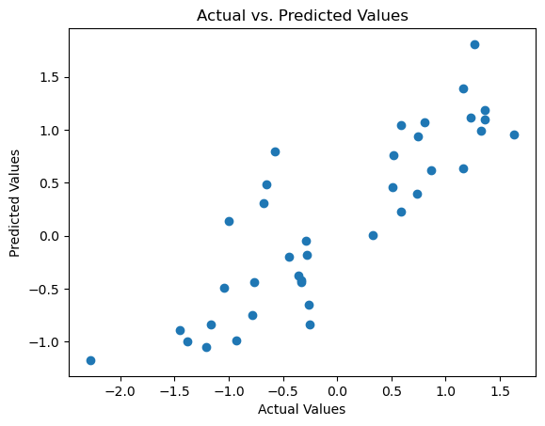
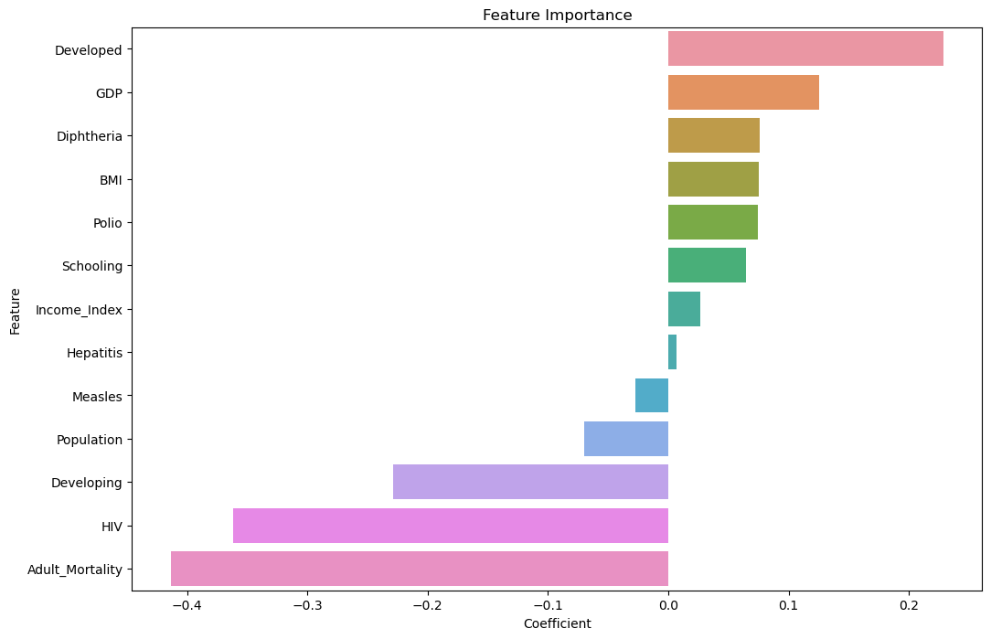
Linear Regression – Feature Importance
The R2-score, a measure of goodness of fit, is 0.712. This suggests that approximately 71.2% of the variance in our dependent variable is explained by the features in our linear regression model.
The Mean Squared Error (MSE) is 0.272235. This metric quantifies the average squared difference between our model's predictions and the actual values, indicating a relatively accurate fit
The Mean Absolute Error (MAE) is 0.400302, providing an average absolute difference between predicted and actual values. This measure gives us a clearer sense of the model's prediction accuracy

Slide 7
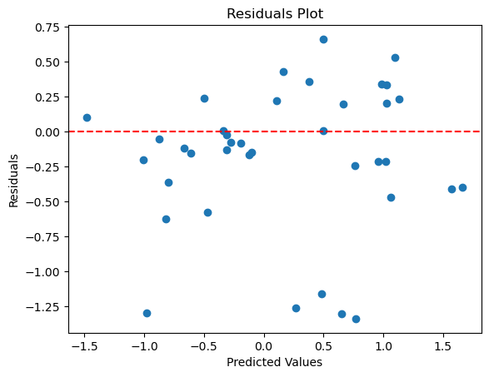
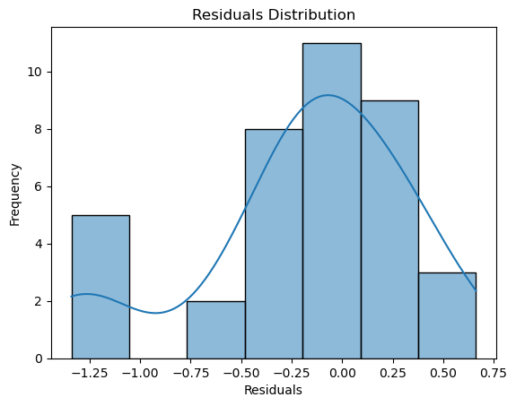
RESIDUAL CALCULATION FOR LINEAR REGRESSION SIGNIFICANT MODEL
The R2-score for significant LR model is 0.683653, indicating that approximately 68.4% of the variance in the dependent variable is explained by the features in our linear regression model.
The Mean Squared Error (MSE) is 0.299433. This metric measures the average squared difference between our model's predictions and the actual values, providing an assessment of prediction accuracy
The Mean Absolute Error (MAE) is 0.392669. This represents the average absolute difference between our model's predictions and the actual values, offering a more interpretable scale for prediction accuracy
While slightly lower than the previous model, the R2-score of 0.683653 still indicates a substantial explanatory power of the included features in our linear regression model

Slide 8
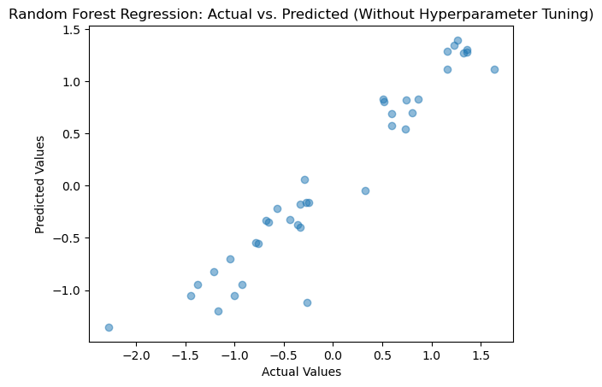
RANDOM FOREST REGRESSION – WITHOUT HYPERPARAMETER TUNING
The R2-score for Random Forest model is exceptionally high at 0.901675. This signifies that approximately 90.2% of the variance in the dependent variable is explained by the features, indicating a strong predictive capability.
The (MSE) is impressively low at 0.093067. indicating a high level of accuracy.“
The Mean Absolute Error (MAE) is 0.221564 providing a clear understanding of the model's precision.“
The Random Forest model, even without hyperparameter tuning, demonstrates remarkable strength in capturing the underlying patterns within the data, as evidenced by the high R2-score and low MSE and MAE values

Slide 9
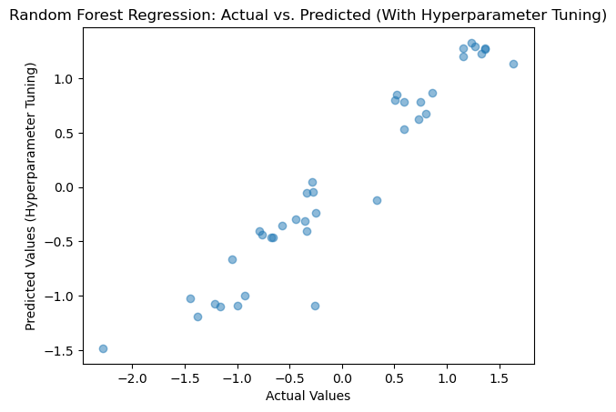
RANDOM FOREST REGRESSION WITH HYPERPARAMETER TUNING
The R2-score for tuned Random Forest model is notably high at 0.913010, indicating that approximately 91.3% of the variance in the dependent variable is explained by the features.
The (MSE) is impressively low at 0.082339,showcasing a significant improvement in accuracy.
The (MAE) is 0.213277,suggests enhanced precision in our tuned model
The hyperparameter tuning process has resulted in a Random Forest model with superior performance, as evidenced by the higher R2-score and the substantial reduction in MSE and MAE values

Slide 10
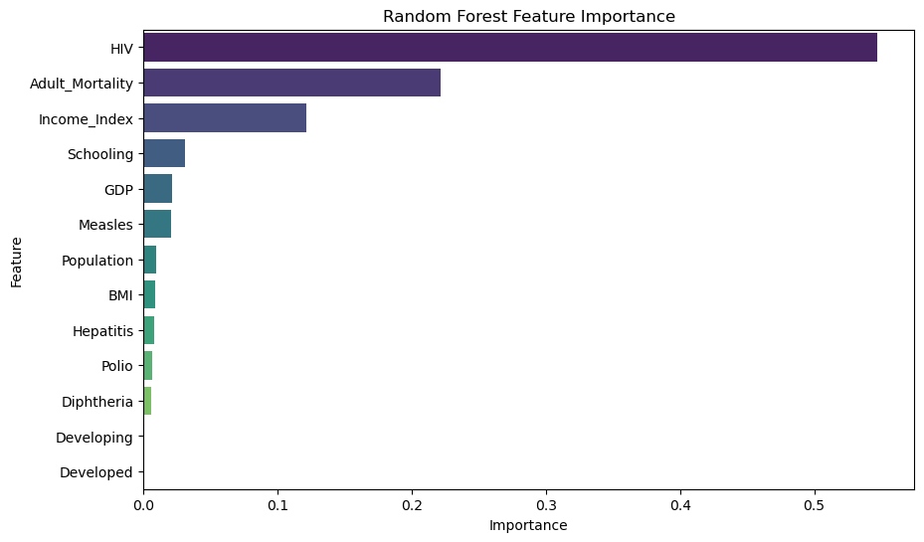
RANDOM FOREST FEATURE IMPORTANCE
The most influential features, along with their respective importance scores, are as follows:
HIV: 0.547406 ~ 54%
Adult Mortality: 0.221290 ~ 22%
Income Index: 0.121018 ~ 12%
Schooling: 0.031049 ~ 31%
GDP: 0.021273 ~ 21%
HIV stands out as the most impactful feature, followed by Adult Mortality and Income Index. This suggests that factors related to HIV prevalence have the most significant influence on our model's predictions

Slide 11
MODEL COMPARISON
Random Forest models outperform Linear Regression, underscoring the advantages of ensemble learning in capturing complex relationships within the data.
The significant improvement in model performance with hyperparameter tuning emphasizes the importance of optimization for fine-tuning predictive accuracy.
The Random Forest model with hyperparameter tuning emerges as the optimal choice for our predictive task, offering a fine balance between accuracy, complexity, and generalizability.
SI.NO | MODEL NAME | R2 SCORE | MSE | MAE
1. | Linear Regression Full | 0.712388 | 0.272235 | 0.400302
2. | Linear Regression Significant | 0.683653 | 0.299433 | 0.392669
3. | Random Forest without hyperparameter tuning | 0.901675 | 0.093067 | 0.221564
4. | Random Forest with hyperparameter tuning | 0.913010 | 0.082339 | 0.213277

Slide 12
POST MODEL CONCLUSION – CHOOSING THE BEST MODEL
Choosing Random Forest with Hyperparameter Tuning as the best model has the below mentioned reasons
Higher predictive accuracy
Random Forest, especially when fine-tuned through hyperparameter optimization, often delivers higher predictive accuracy compared to other models. The achieved R2-score of 0.913010 indicates a superior ability to explain the variance in the target variable.
Consistent Performance across Metrics:
The model exhibits consistently low values for both Mean Squared Error (MSE) and Mean Absolute Error (MAE). These metrics, coupled with the high R2-score, indicate that the Random Forest with hyperparameter tuning consistently outperforms other models in terms of accuracy and precision
Reduction in Overfitting:
Hyperparameter tuning helps in optimizing model parameters, reducing the risk of overfitting. By finding the right balance between model complexity and generalization, the tuned Random Forest is more likely to perform well on unseen data.
.

Slide 13
CONCLUSION
Random Forest with hyperparameter tuning is recommended for its superior predictive accuracy, robust handling of complex relationships, reduced overfitting, fine-tuned configuration, and consistent performance across evaluation metrics

